Slide 1


MICRSOFT TEAMS
MICROSOFT
TEAMS
THE HUB OF TEAMWORK IN OFFICE 365

Slide 2
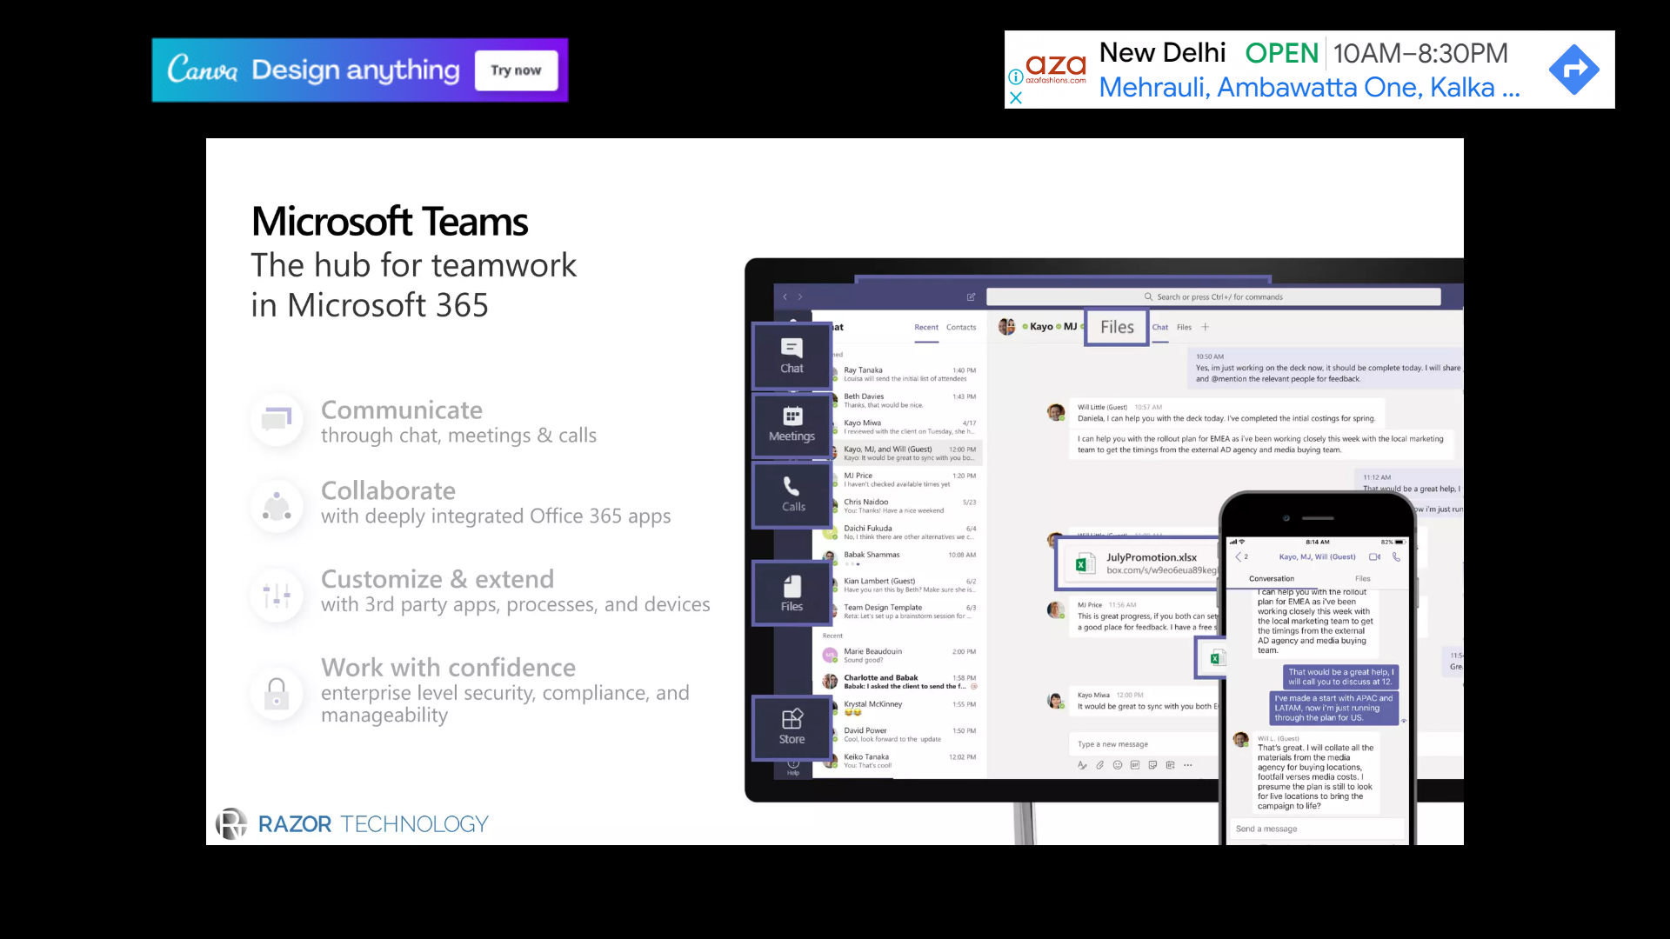




COMMUNICATE
through chat, meetings & calls
collABORATE
with deeply integrated office 365 apps
CUSTOMIZE & EXTEND
with 3rd party apps, processes and devices
work with CONFIDENCE
enterprise level security, compliance and manageability
USE OF WhiteboArd

Slide 3
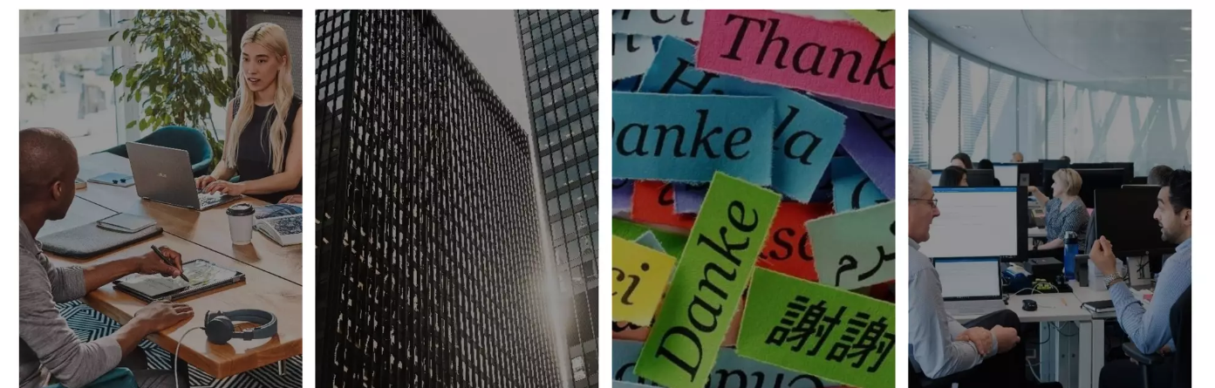
Teams is the fastest growing business app in
microsoft histrory
329,000
87
44
60
Organization use teams
Fortune 100 companies uses
teams
Languages are supported
in teams
Customers have 10,000
or more active users

Slide 4
DEMO

Slide 5

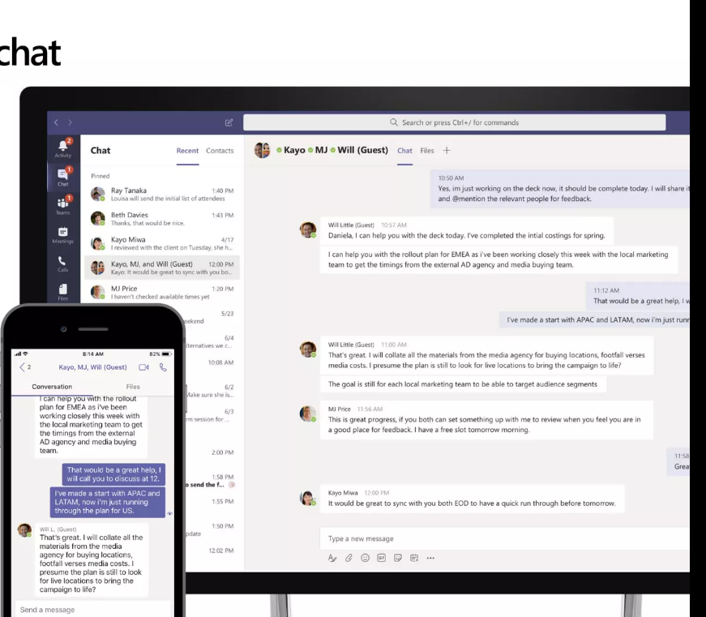
COMMUNICATE THROUGH CHAT
Communicate across geographies language in an organization
Share information in an open and
transparent way with threaded persistent
channel discussion
Stay in sync with 1:1 or group chats
2
Communicate across geographies,
languages and organization with
guest access, federation and
translation
3
Humanize the workplace with gifs,
stickers and emoji.
Available across mobile, desktop, browser
and a wide range of devices from headset to
surface hub to meeting room

Slide 6
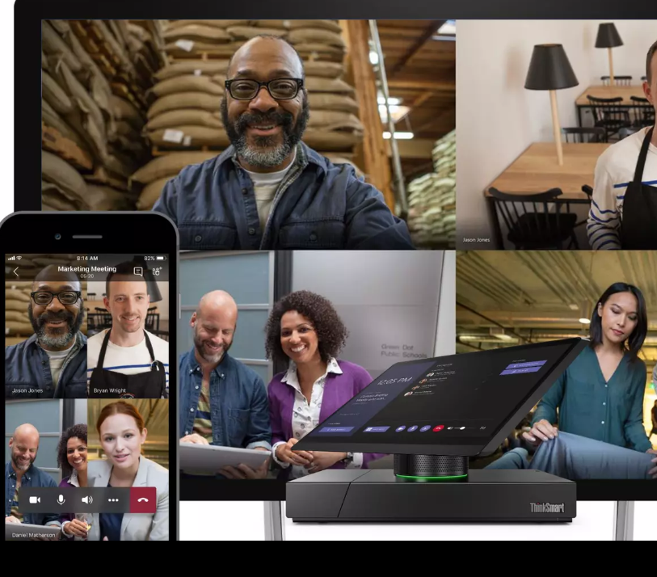
COMMUNICATE THROUGH MEETINGS
Communicate from anywhere with a complete meeting solution
Stay connected with a complete meeting
solution supporting sharing, video and audio
conferencing
Engage in all types of meeting- spontaneous,
scheduled, external and large 1:manys
2
Get work done faster by having context and
content at your fingertips.
Stay in know with meeting recordings with
transcription and translation, indexed for
searching,
3
Join from a range of platform and devices,
including desktop, browser, mobile and
meeting, room devices.

Slide 7
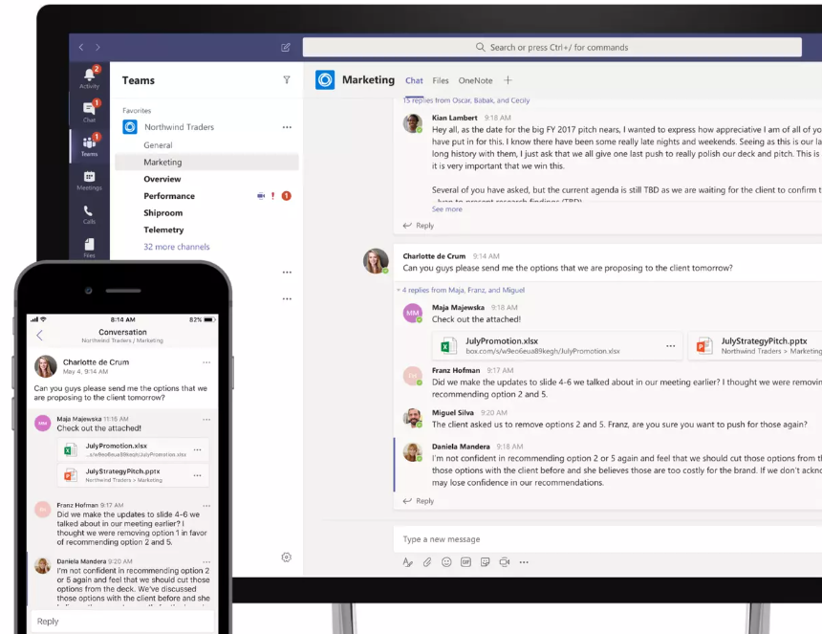
COLLABORATE WITH INTEGRATED OFFICE 365
Quick access to the apps you love
Access your files along with related chats and apps in one consolidated workspace.
Share and Co-author office and other files
with the app
2
Reduce context switching with built in access
to office 365 apps- Sharepoint, One Note,
Power BI, Planner, flow and Power Apps
3
Search across people, files and chats to find
what you need- leveraging intelligence from the
microsoft Graph
Keep the whole team in the loop with email
integration notifications

Slide 8

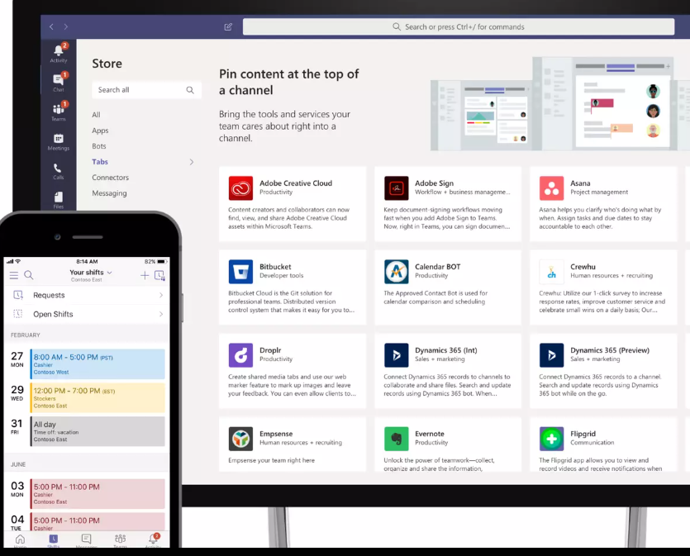
CUSTOMIZE AND EXTEND
Personalizeed your workspace to include the apps & services youu love
Customize your channels by pinnig important files, apps or dashboard for easy reference.
Add 3rd-party services so the team can quickly
access information when needed
2
Integrate workflow to simplify processes
and accelerate decision-making
3
Build integrated to existing buisness apps
with the Teams developer platform
Empower Firstline Workers with tools to succeed
everyday, including schedule management

Slide 9
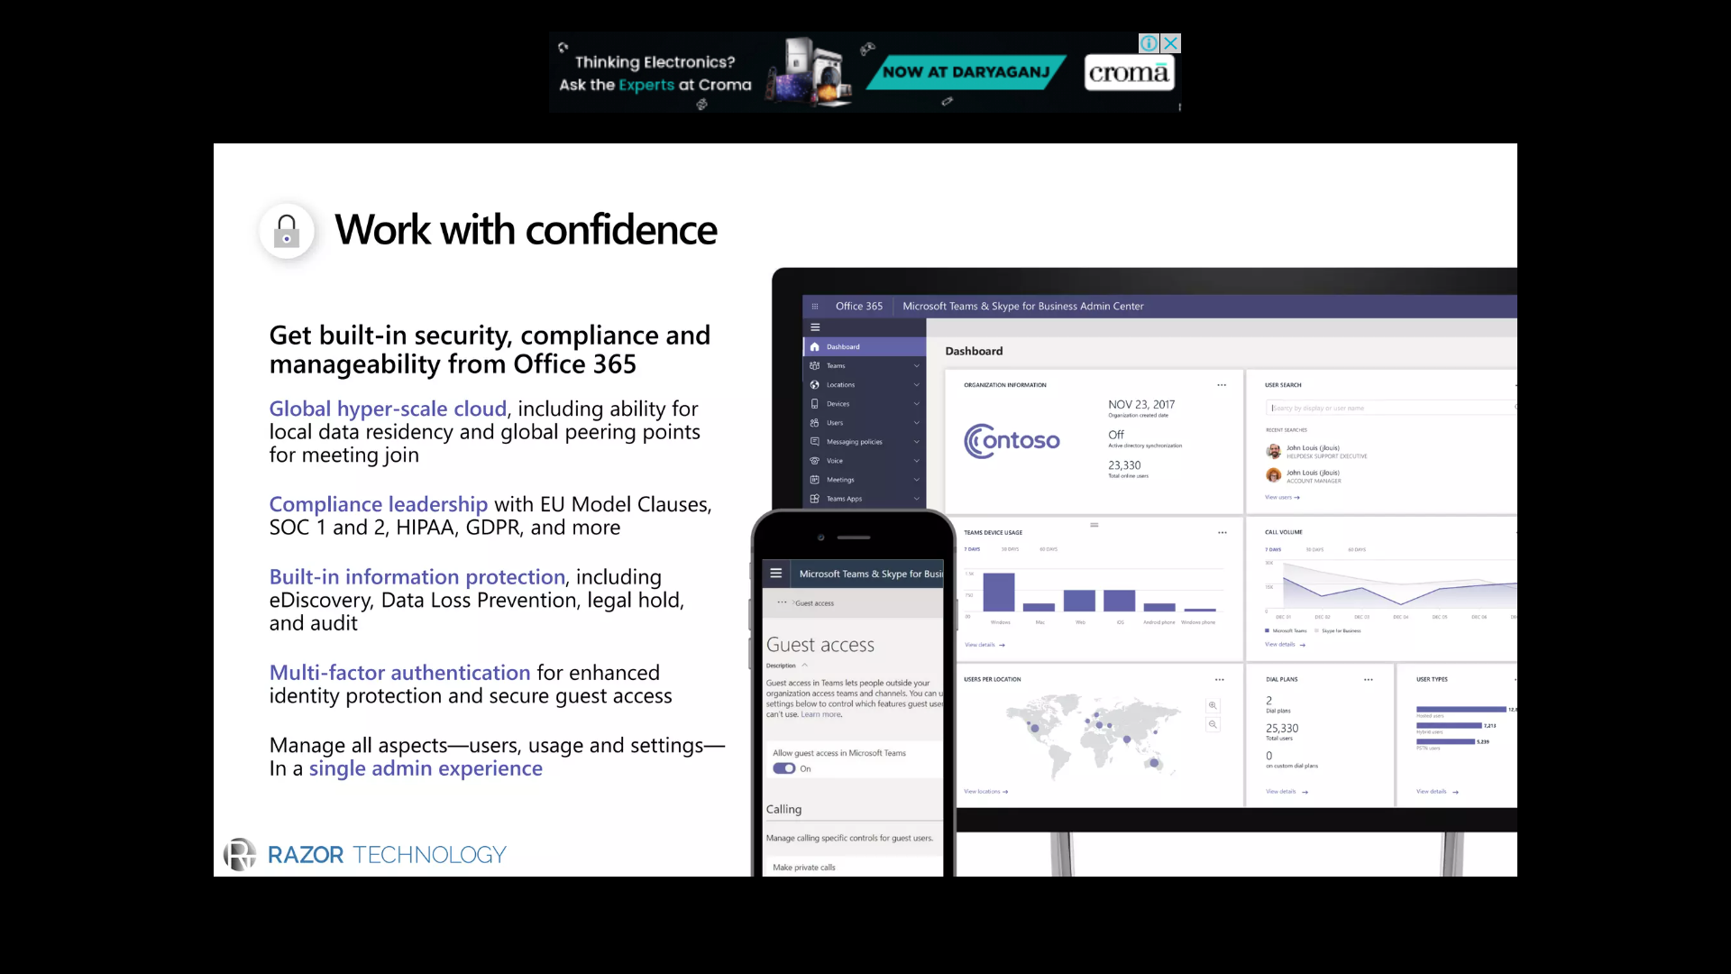
WORK WITH CONFIDENCE
Get built-in security, compliance and manageablity from Office 365
Global hyper- scale cloud, including ability for local data residency and global peering points for meeting join
2
Built-in information protection, including ability
eDiscovery, Data Loss Prevention, legal hold, and
audit
3
Multi-factor authentication for enhanced indentity
protaction and secure guest access
Manage all aspects-users , usage, and setting
in a single admin experince.

Slide 10
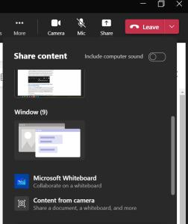
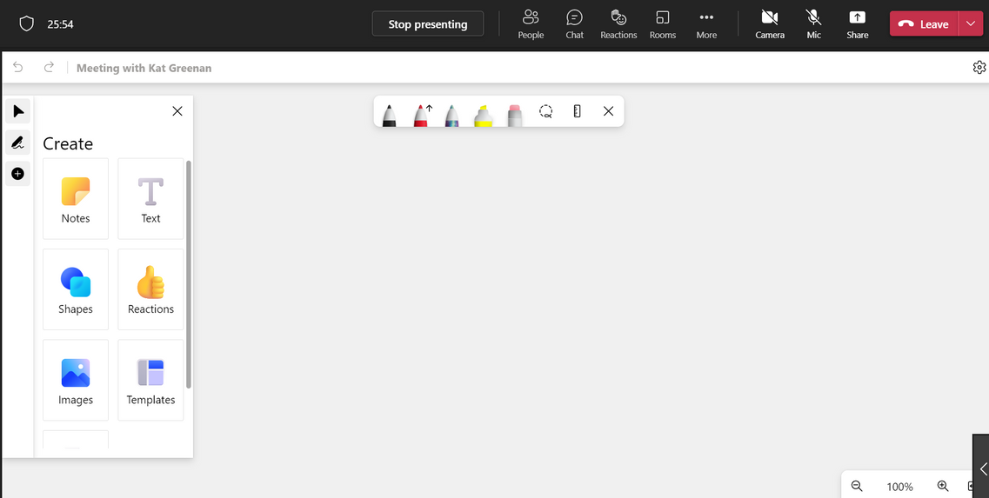
WHITEBOARD IN A MICROSOFT TEAMS MEETING
whiteboard in Microsoft Teams which allows the presenter and other users to visually present information to other colleagues.
TO USE THE WHITEBOARD FEATURE IN MICROSOFT TEAMS:
The first thing to notice in the new and improved whiteboard is the content on the left-hand side. Now we can add reactions, shapes, images and even use templates.
The Whiteboard is accessible in a Teams meeting by clicking on share and then sharing the whiteboard app.

Slide 11
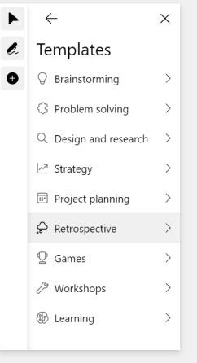
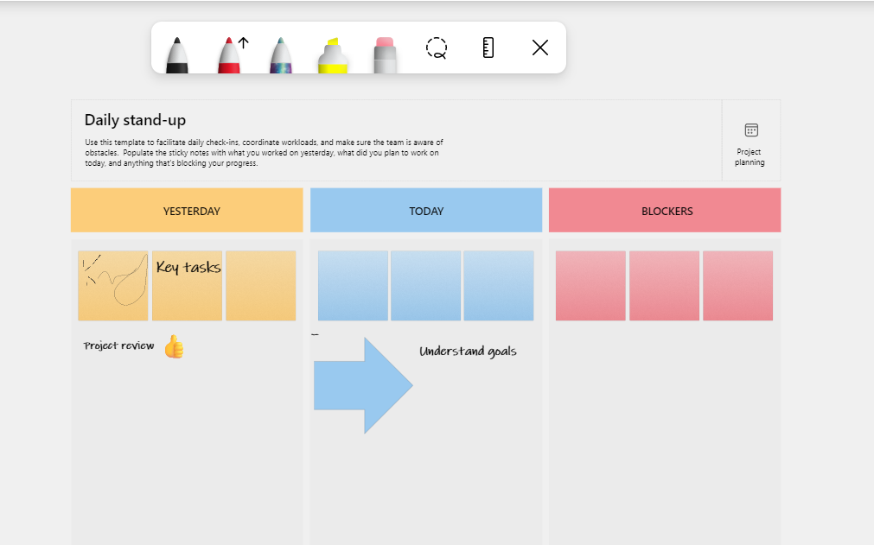
WHITEBOARD IN A MICROSOFT TEAMS MEETING
Under templates you can choose from different categories such as brainstorming or workshops.
We can edit, delete, move things around, draw, and add shapes and text within the template.

Slide 12
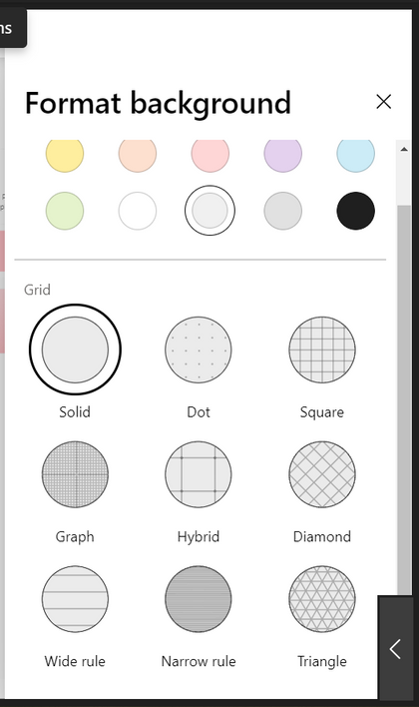
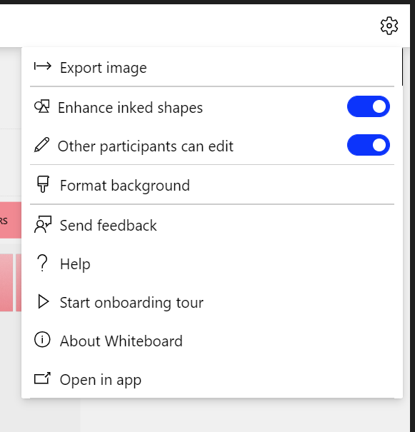
WHITEBOARD IN A MICROSOFT TEAMS MEETING
we can make the whiteboard read-only in the settings, meaning others cannot collaborate. I can also export the whiteboard as an image or open it directly in the Whiteboard app.
We can also format the background to add colours or lines, depending on why I use the whiteboard.

Slide 13
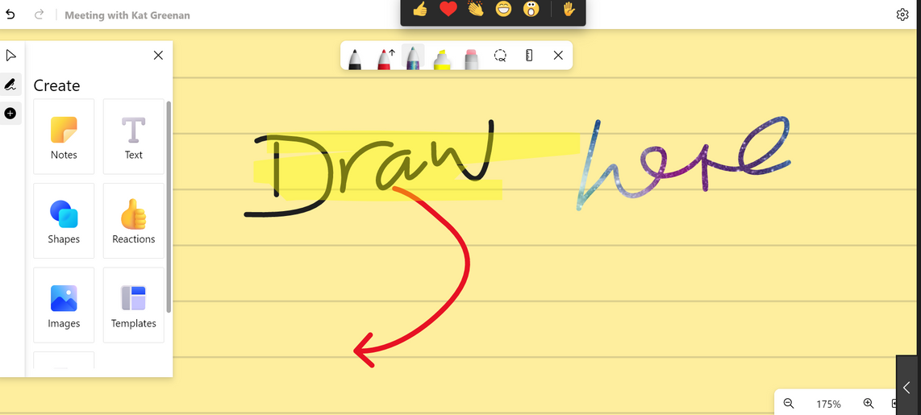
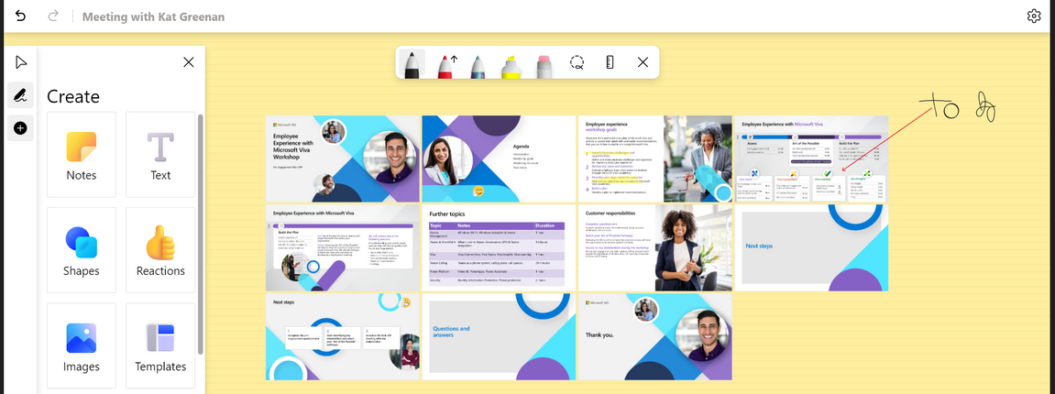
WHITEBOARD IN A MICROSOFT TEAMS MEETING
Adding lines makes it easier for me to draw on the whiteboard, and I can zoom in and out depending on how big I want the lines to be.
We add files to the whiteboard as well. When we click the documents button, We can add a file from my OneDrive and insert it directly into the whiteboard. we can choose which slides we want to insert and even annotate the slides with a PowerPoint.

Slide 14
Day, Date
IT, Department
STUDENT
Thank you
for listening!

